Slide 1
AI Digital Innovation Hubs Network
Study carried out for the European Commission - DG CNECT by
One of AI DIH Pioneer

Slide 2
AI DIH Network : The project
Call of interest :
30 DIH selected from 20 different countries
25 DIH signed the cooperation agreement in November 2019
Objective:
Develop a structured cooperation approach among DIHs:
to create a European Network of Digital Innovation Hubs with focus on AI,
to provide policy recommendations for enhancing DIHs’ collaboration.
Programme:
Blueprint for cooperation
Policy recommendation
Frame work cooperation agreement
Web Site : https://ai-dih-network.eu/index.html

Slide 3
AI DIH : blueprint for collaboration
What it means to be an AI DIH:
the service offering,
the competences and skills
the operating model
For DIHs: How to get ready for collaboration
how to assess the potential of cooperation
How to evaluate DIH’s readiness to cooperate
Building and maintaining your network
The cooperation scenarios
Deliver a service in partnership with other DIHs and build synergies in terms of skills and assets
Develop a new service
Create new opportunities for their ecosystems by facilitating the identification of business, commercial and technical partners in other regions
Policy recommendations to strengthen cooperation

Slide 4
Blueprint for collaboration: AI DIH profile : Service offering
Strategic support to RDI Contract research
Technical support on scale up
Testing and validation, including Ethical AI Certification
Provision of infrastructure
Test before invest
AI Digital Innovation Hubs role :
One-stop-shops, providing services in the field of AI
Services Clustered into the 4 functions according to the DEP.
No need to offer all the services to be considered an AI DIH.
Strategic and business development, including AI maturity assessment and AI service impact assessment
Support facilities /Incubator and accelerator support Funding lifecycle management support
Legal and ethical AI support
Support to find investments
Ecosystem scouting, engagement and management, including relationships between DIHs of the network
Ecosystem coordination for projects
Innovation ecosystem and networking
Training, including executive courses on AI and innovation and lifelong training on AI-focused technical and soft skills
Talent and skills match making
Awareness raising, including the organisation of awareness raising campaigns on AI
Skills and training

Slide 5
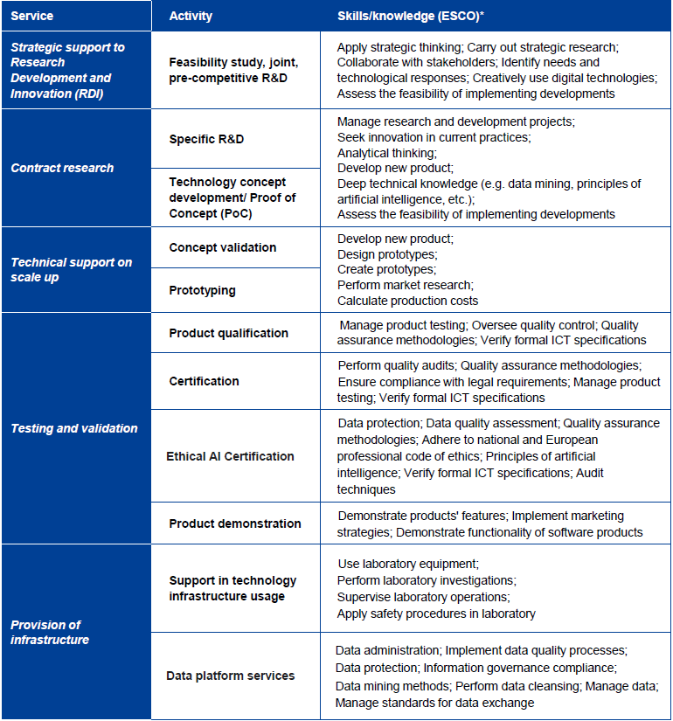
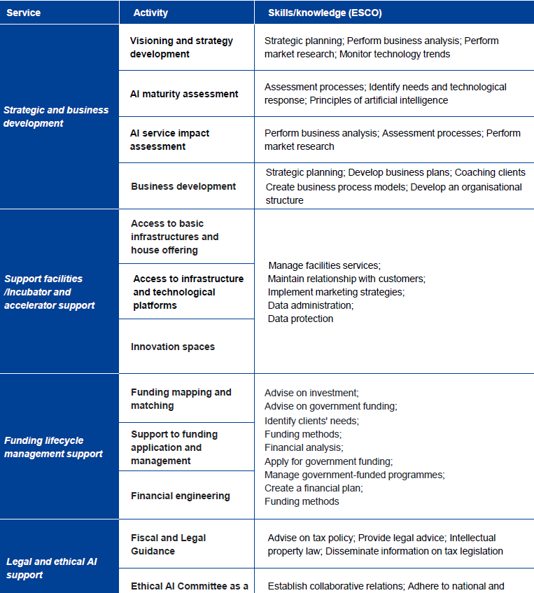

Slide 6
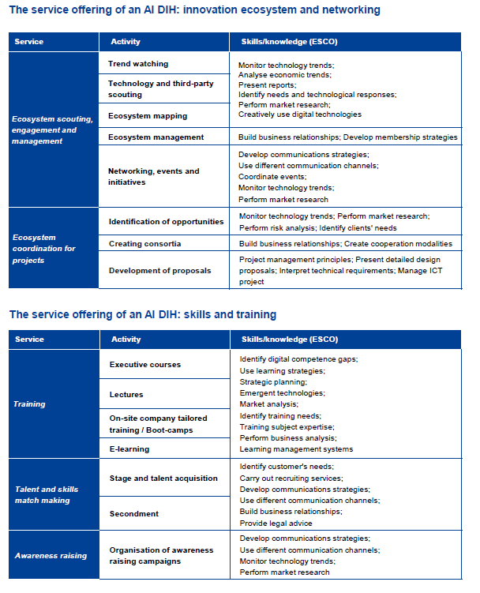

Slide 7
Blueprint for collaboration: AI DIH profile: Competences and skills
Transversal competences
Quality management and risk assessment
Management and entrepreneurship
Communication across different contexts
Emotional intelligence and ethical behaviour
Transversal knowledge of the principles and disciplines behind Artificial Intelligence
AI DIHs should be able to leverage on both:
transversal competences
technical skills and knowledge related to AI.
No need to have these competencies internally:
DIHs have to take advantage of those available in the Network by activating collaboration.
Technical skills related to AI
Knowledge of AI principles and skills to utilise machine learning
Competences that underlie the development of AI solutions and algorithms (e.g. computer science, software design, mathematics, statistics, etc.)
Appropriate governance, management, protection and storage of data which are at the basis of the development and test of AI solutions
7

Slide 8
Blueprint for collaboration: AI DIH profile: Operating model
Operating model of a DIH defining :
strategy outlining the DIH mission and key intervention areas
funding mechanisms
clear and flexible governance
detailed processes for the most relevant activities
introduction of the ethical AI component
framework of KPIs and metrics to monitor effectiveness and track
effective communication strategy
access to both physical and virtual infrastructures (may include HPCs, virtual environments, IoT sensors and platforms, as well as datasets)

Slide 9
How to get ready for collaboration how to assess the potential of cooperation
DIH should start from the analysis of its customers:
defining their requirements,
how it is responding to them
and understanding how its offerings can be improved by the collaboration with other DIHs
Customer journey mapping exercise :
can help DIHs to improve DIH capacity to meet the need of its customers and its ecosystems.

Slide 10
For DIHs: How to get ready for collaboration How to evaluate DIH’s readiness to cooperate
Before undertaking a collaboration DIH should be aware of the resources it can leverage and of the barriers and limits it may need to overcome
we have prepared a questionnaire working as a self- assessment to understand the changes required before starting a cross-border collaboration.
Potential partners
Legal status
Internal structure and resources
Are you aware of the competencies and skills your partner should have?
Are you able to contact specific potential partners?
Are you registered on the JRC catalogue of DIH?
Is it possible to find clear information on your DIH and the service it offers online?
Does your legal status enable you to offer services to DIHs/ clients in other regions?
Can your DIH receive payments for the service it provide?
Do you have standard procedures for establishing collaborations?
Have you experience in negotiating and signing collaboration agreements?
Do you have sufficient staff and resources to engage into networking and information events?
Do you have resources to respond to collaboration request for your partners?

Slide 11
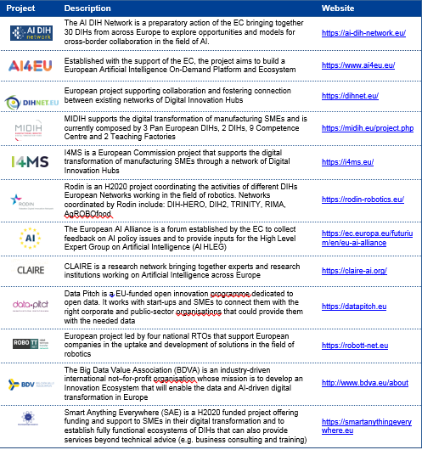
For DIHs: How to get ready for collaboration Building and maintaining your network
Existing European AI-related initiatives and networks of DIHs a good starting point for DIHs interested in identifying potential partners and explore AI-related collaborations.
The Digital Innovation Hubs Catalogue is the official European repository of existing DIHs across Europe : https://s3platform.jrc.ec.europa.eu/digital- innovation-hubs-tool

Slide 12
AI DIH : The 3 Cooperation Scenarios
Development of a new service
Partnership to deliver service jointly
Partnership to deliver service jointly
How it works
DIH1 looks for partners with complementary or similar competencies willing to take part in the development of the service. This phase can be implemented starting from a platform mapping DIHs’ competencies or simply contacting DIHs located in the same/different ecosystem.
DIH1 discusses together with interested DIHs (DIH2 and DIH3) the potential cooperation opportunity and the features of the services that should be developed.
The three DIHs co-create and sign a cooperation agreement, reflecting the strategy and covering related legal and financial issues (e.g. IPR of the service and contents developed).
The three DIHs implement the strategy and activities agreed. Once the service is developed, each DIH delivers it to its ecosystem.
Horizontal tools supporting the implementation of the scenario
Regular face-to-face meetings/working groups to facilitate DIH awareness of each other activities
Platform/ tool for knowledge sharing (e.g. share information on available data sources, recommended providers, use cases, lessons learnt, etc.)
How it works
The Client asks for support to its local DIH (DIH1). After analysing its request, DIH1 realises it will not be able to deliver the service by its own and looks for the other hubs belonging to the Network that owns the necessary competences.
DIH1 identifies possible partners and contacts them to partner up. The contacted DIH(s) (i.e. DIH2 and DIH3) analyse the proposal and decide whether to discuss the opportunity with DIH1. If they are interested in the opportunity, they will also explore a potential cooperation.
The involved DIHs co-create and sign a cooperation agreement, specifying roles and responsibilities in the delivery of the joint service and KPIs of the cooperation.
The involved DIHs jointly deliver their bundled services to SMEs. DIH1 acts as the contact point for the client ad and coordinator of the activities.
Horizontal tools supporting the implementation of the scenario
Platform information on services, competencies, skills and AI testing facilities of the potential partners
Regular face-to-face meetings/working groups to facilitate DIH awareness of each other activities
How it works
The Client asks for support to its local DIH (DIH1). After analysing its request, DIH1 realises it will not be able to deliver the service by its own and looks for the other hubs belonging to the Network that owns the necessary competences.
DIH1 identifies possible partners and contacts them to partner up. The contacted DIH(s) (i.e. DIH2 and DIH3) analyse the proposal and decide whether to discuss the opportunity with DIH1. If they are interested in the opportunity, they will also explore a potential cooperation.
The involved DIHs co-create and sign a cooperation agreement, specifying roles and responsibilities in the delivery of the joint service and KPIs of the cooperation.
The involved DIHs jointly deliver their bundled services to SMEs. DIH1 acts as the contact point for the client ad and coordinator of the activities.
Horizontal tools supporting the implementation of the scenario
Platform information on services, competencies, skills and AI testing facilities of the potential partners
Regular face-to-face meetings/working groups to facilitate DIH awareness of each other activities

Slide 13
Policy recommendations: to strengthen cooperation Co-drafting process and key topics
Supporting DIH collaboration in the Digital Europe Programme
Horizontal actions to support
networking and cooperation
Future development of the DIHs
R1: Experiment and demonstrate the effectiveness and benefits of the cooperation scenarios within EU programmes and projects
R2: Define additional cooperation mechanisms for European DIHs and other DIHs
R3: Incentivise collaboration until it becomes a well-established mechanism
R4: Ensure support to settle legal aspects of collaboration
R5: Reinforce thematic communities within the Digital Transformation Accelerator
R6: Define the competency framework of European Digital Innovation Hubs
R7: Reinforce the assessment of DIHs services and infrastructure in the selection of European Digital Innovation Hubs to ensure consistency and to create a cohesive community
R8: Develop and promote a standard classification for DIH services and skills
R9: Organise European workshops and demo-days for the participation of DIHs with competences in concrete technological disciplines
R10: Develop a unique, proactive platform for supporting DIHs collaboration
R11: Establish a sustainable independent back office function to animate and coordinate long-term DIH Network collaboration and growth
R12: Ensure consistency and coordination among the different initiatives connected to AI and DIHs
R13: Leverage DIHs to pursue EU priorities
R14: Prepare DIHs to work with the Public Sector

Slide 14
Framework Cooperation Agreement
Purpose of the Framework Cooperation agreement:
foster cross-border collaboration among DIHs.
by implementing co-designed cooperation schemes,
A template of an ad-hoc service agreement
was developed to support DIHs to regulate collaboration initiatives.
The template foresees different options to facilitate Hubs in tailoring the agreement to their needs.
The Agreement touches on the following key topics:
Governance of the Network:
Rotating Presidency :
Rotate among the Pioneers (i.e. the current 25 DIHs that entered into the Agreement) on a voluntary basis, changing every twelve months.
in charge of coordinating the activities of the network.
The technical secretariat
The members of the Consortium managing the preparatory action have decided to set up a Technical Secretariat to support the Presidency of the Network at least until the end of 2020.
Key responsibilities include:
Maintenance of the project public website
Support to relationship with key stakeholders
Support to networking and other activities
Support in the admission of new joiners
Confidentiality
Liability of the parties
IPRs and know-how
Data protection
Relationships with the clients
Non-compete

