Slide 1
IVADO delegation
Montréal : Mon 7 – Thu 10 Oct 2019

Slide 2
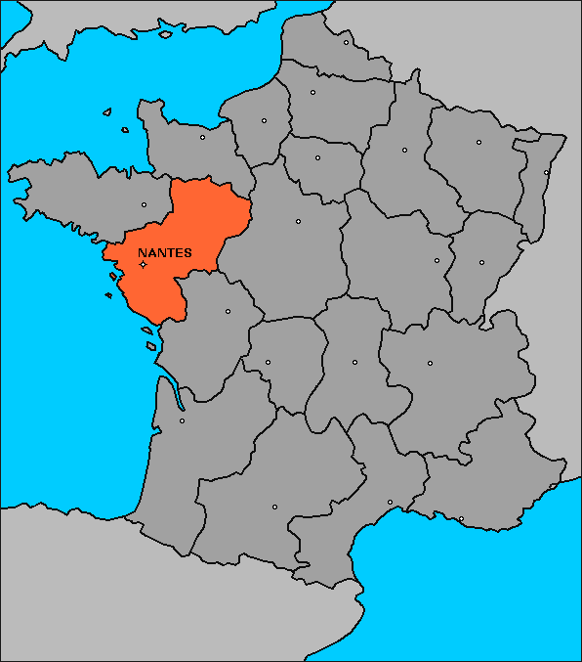
Atlanstic 2020 (A2020)
a 5 M€ regional program funded by Pays de la Loire Council, EU and academic+ partners
Located in Nantes, Angers and Le Mans-Laval

Slide 3
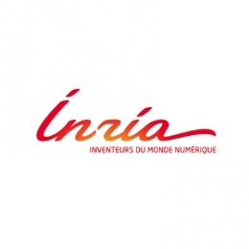
Atlanstic 2020 academic partners (1)
Public institutions of Higher Education and Research
3 Universities : Nantes, Angers and Le Mans
2 Engineering Schools : Centrale Nantes and IMT Atlantique
2 National Research Institute : CNRS/INS2I and Inria
Notes:
Inria = the French national research institute for the digital sciences https://www.inria.fr/en/
INS2I = Institut des sciences de l'information et de leurs interactions

Slide 4
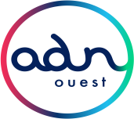
Atlanstic 2020 other partners (2)
(Inter)régional networks for innovation
3 Clusters : I&R (digital innovation), EMC2 (production technologies) and Atlanpole Biotherapies (bio medicine)
1 Professional Network : ADN’Ouest (digital expertise)
3 Cities : Nantes, Angers and Le Mans
Notes:
3 interreguional clusters
Media & Networks is the reference cluser of digital innovation

Slide 5
Atlanstic 2020 and Research Laboratories
Federating 4 research laboratories (600+ members)
LS2N : Nantes Laboratory of Digital Sciences
LARIS : Angers Laboratory in Computer Engineering
LERIA : Angers Laboratory in Computer Science
LIUM : Le Mans Laboratory in Computer Science
Sharing fields of expertise in
Data Science
Software Science
Robotic
Contents and Interactions
Complex Systems
Focusing on 2 application domains
Health
Industry
Cooperating with
NII @ Tokyo
IVADO @ Montréal

Slide 6
Atlanstic 2020 and Graduate Programs
1800+ Graduated Students
Baccalaureat
BAC+2
4 DUT (Diplômes Universitaires de Technologie)
DUT Informatique (Nantes, Laval)
DUT Génie Electrique et Informatique Industrielle (Nantes, Angers)
DUT Métiers du Multimédia et l’Internet (Laval)
DUT Réseaux Télécommunications (Nantes)
BAC +3
1 Licence – 10 Licences Pro
Licence Informatique (Nantes, Angers, Le Mans)
Licences Pro (Nantes, Angers, Laval) : réseaux, administration, télécommunication, développement, test et qualité, base de données…
5 Masters
Informatique (Nantes, Angers, Le Mans)
Méthodes informatiques appliquées à la gestion des entreprises MIAGE (Nantes)
Automatique et robotique (Nantes)
Mathématique et application (Angers)
Management and Optimization of Supply Chains and Transport MOST (Nantes)
5 Diplômes d’ingénieur
Polytech Nantes
Polytech Angers
ENSIM Le Mans
Centrale Nantes
IMT Atlantique
Maitrise
BAC +5
Doctorat
BAC +8
1 école Doctorale
Math-STIC

Slide 7
Current objectives
Launching scientific collaboration with IVADO laboratories through
Postdoctoral funding
Sabbatical packages for welcoming IVADO visiting professors
Sabbatical packages to support A2020 professors while visiting IVADO
PhD thesis co-advising and co-funding
Associated international team supporting scientific collaboration projects between A2020 and IVADO research teams
Master students exchanges
Double degree programs for engineers

Slide 8
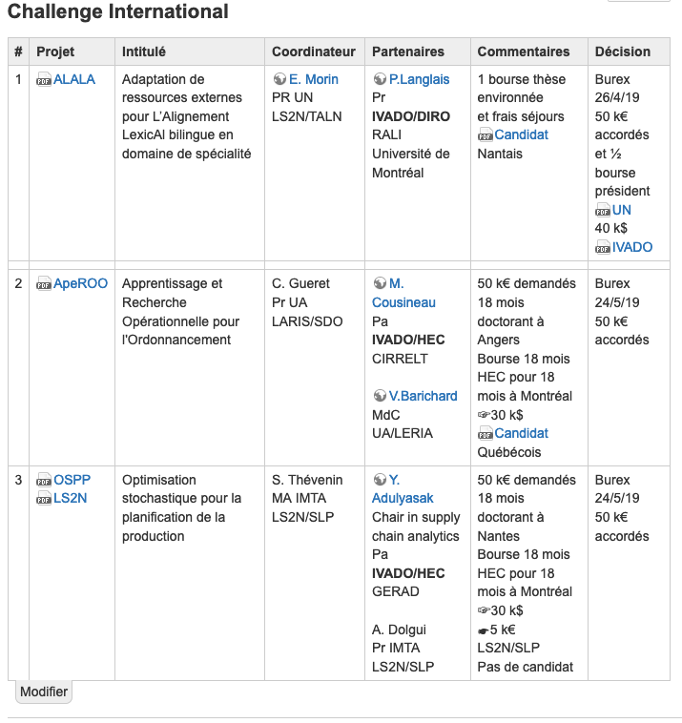
PhD thesis co-advised and co-funded

Slide 9
A2020 Open Calls for Projects
International exchanges
A2020 Visitor package
to stay 6 months over a 3 years period as a visitor researcher
the grant is covering travel and accommodation costs up to 20 K€
A2020 Sabbatical package
to stay 6 month in a row in one of the IVADO laboratories.
the grant is also covering travel and accommodation costs up to 20 K€
Joint research project
A2020 International Challenge (200 k€ still available for 2019)
funding one year post-doc for a common project between research teams from A2020 and IVADO.
Co-funding PhD students
to be developed

