Slide 1
TERALAB DIH

Slide 2
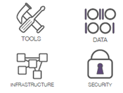
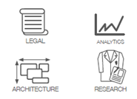
your organization
Boost ’s aI & BIG DATA INITIATIVES
OPEN INNOVATION
EDUCATION
RESEARCH
SANDBOX
SERVICES
TRUSTED R&I BIG DATA & AI PLATFORM
TeraLab team +
Startups & academics
SECURITY &
SOVEREIGNTY
NON PROFIT
TECHNOLOGICAL TRANSFER
SUCCESS:
70+ PROJECTS
Notes:
TeraLab has been conceived for Innovation, Education and Research, it provides both an infrastructure and services (consulting, relationships)
It bases on the principles of security and sovereignty → very relevant currently in Europe Being a non profit help us earn the trust of our customers
The goal is to favor the successful migration of projects realized in TeraLab to a production environment. One strategy for this is to conceive environment-independent projects
From 2014 we have over 70 projects that allow us to capitalize on knowledge, that we bring into subsequent projects

Slide 3
Over 70 projects in multiple sectors
Industry
Mobility
Energy
E-government
Logistics
Health
Insurance
Cybersecurity
Agriculture
Notes:
3 strategic/ priority domains

Slide 4
Teralab
European strategy
One of 30 AI DIHs
Only labelled i-Space in France 2016, 2017, 2018, 2019 - Silver
2020 - Gold
The French Hub
Founding member
4

Slide 5
Infrastructure architecture
Core TeraLab
User demand:
flexibility
Custom infra (sizing, topology)
Recent (often immature) technologies
Complex environment
Specification changes
Fast learning curve / Support / Consulting
Easy migration to production
...
Data owner demand:
reliability
Architecture/technology
Isolation against Internet/other TeraLab projects
Authentication, cryptography, firewall, proxy, VPN
Sovereign & reliable datacenter
Quality / Process (e.g. Incident management)
Risk awareness
...
Complex technology
Network, storage, virtualization
DevOps
Intrusion detection
…
Plan steps
Specify the workspace configuration
Get data owner approval regarding data export
Setup the workspace (VMs, tools, user accounts)
Export data from data owner to TeraLab (after dry test)
Extract relevant archives
Delete the workspace (erase all data)
…
…

Slide 6
Highly customizable configuration
Autonomous
Data Scientist
Servers size
CPU, RAM, storage
Topology
Inter servers access
Tools:
Install & config
Support
Architecture, remediation
Risk analysis + actions
Others
Backup
Workspace destruction
…
Limited SysAdmin skills available in project team
TeraLab
Workspace
Data Science
Area
Turn Key
TeraLab large administration scope
Administered
TeraLab data leak mitigation
Autonomous
Some sudoer project members
N/A
Internet
Turn Key
Data Sponsor
Data Scientist
Confident
data owner
Concerned
data owner
TeraLab
Workspace
Exchange
Area
Data Science
Area
Administered
SysAdmin skills available
In project team
Data Sponsor
Data Scientist
TeraLab
Workspace
Exchange
Area
Data Science
Area

Slide 7
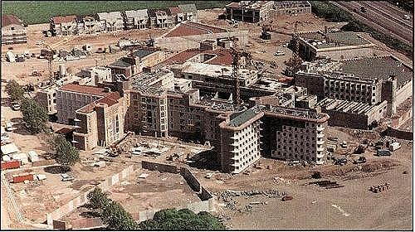
Examples of Security threats
Friends are also threats
E.g. data on data scientist laptop
Jail security is off during its construction
Even the data platform development projects require early experimentation with real data

Slide 8
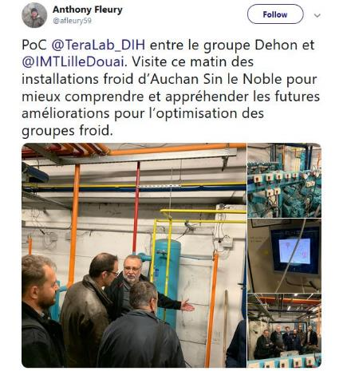
EXAMPLE OF TERALAB SERVICES
Data value chain:
POC together with IMT labs

Slide 9
Le projet Pack IA
Le Projet Pack IA accompagne la PME – ETI concrètement jusqu’à la mise en production
Un Projet IA de 3 mois (37.000 € HT environ)
Un financement à 50% de la Région (18.500 € HT environ)
Un accompagnement personnalisé
Une équipe d’experts
Notes:
sensibilisation aux enjeux et bénéfices de l’IA
conseil personnalisé afin de déterminer un projet IA réalisable en trois mois au sein de l’entreprise
peut aller jusqu’au soutien à la mise en production pérenne de la solution d’IA identifiée

Slide 10
Les étapes du projet Pack IA
La PME – ETI exprime son besoin et apporte ses données. L’équipe Pack IA se charge du reste
1- Pré-qualification
2- Qualification
Entretien Dirigeant – Réalisateur
Collaboration de 3 mois
Approfondissement du projet
Évaluation des performances
3- Réalisation
4- Evaluation

Slide 11
Les partenaires du Pack IA
La Région Île-de-France a choisi pour le projet Pack IA un Consortium d’experts IA
2 Pilotes
5 Réalisateurs
et les start-up membres des réseaux du Hub France IA et de l’IMT-TeraLab

Slide 12
Plateforme technique TERALAB
Faciliter l’usage de l’IA pour les PME et ETI franciliennes en mettant en place un parcours adapté d’appropriation aux technologies d’Intelligence Artificielle
→ du conseil personnalisé fourni par des professionnels experts de l’IA,
→ de l’accompagnement pour la réalisation d’un premier projet
→ l’accès à une plateforme technique de stockage sécurisé pour les données, avec les moyens de calcul adaptés

